Slide 1
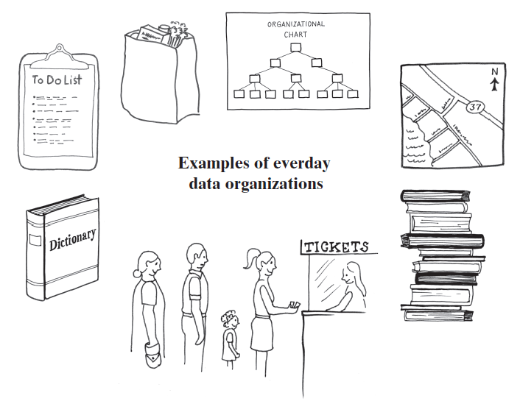
Chapter 2: Bag Implementations that Use Arrays
Manar Mohamed
mohamem@miamioh.edu

Slide 2
Consider the following code. Which string should the user expect to be returned by the call to remove()? Bag bag = new Bag(5); bag.add("cat"); bag.add("dog"); bag.add("house"); String house = bag.remove();
cat
dog
house
null
None of the above

Slide 3
Consider the following code. What is the value of empty? Bag bag = new Bag(5); bag.add("cat"); bag.add("cat"); bag.remove("cat"); boolean empty = bag.isEmpty();
0
true
false
None of the above

Slide 4
Consider the following code with 6 method calls. How many of these 6 method calls will return false? Bag bag = new Bag(1); bag.add("cat"); bag.add("dog"); bag.remove("dog"); bag.isEmpty(); bag.remove(); bag.remove();
1
2
3
4
5
6

Slide 5
A bag with capacity 1:
Bag bag = new Bag(1); bag.add("cat"); // true bag.add("dog"); // false, bag is full bag.remove("dog"); // false, bag does not contain dog bag.isEmpty(); // false, cat is still in the bag bag.remove(); // returns "cat" bag.remove(); // returns null

Slide 6
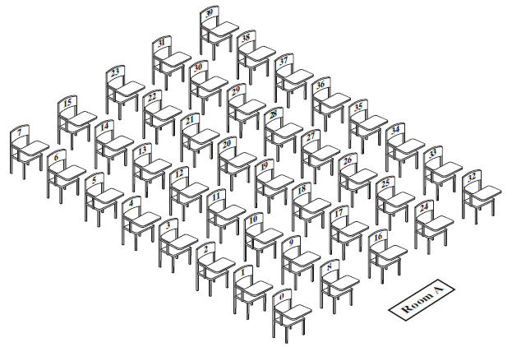
Fixed-Size Array to Implement the ADT Bag
FIGURE 2-1 A classroom that contains desks in fixed positions

Slide 7
What is an advantage of moving a student as just described so that the vacated desk does not remain vacant?
What is an advantage of leaving the vacated desk vacant?
If a student were to drop the course, which one could do so without forcing another to change desks?

Slide 8
Using UML Notation to Specify a Class
Bag
+getCurrentSize(): integer +isEmpty(): boolean +add(newEntry: T): boolean +remove(): T +remove(anEntry: T): boolean +clear(): void +getFrequencyOf(anEntry: T): integer +contains(anEntry: T): boolean +toArray(): T[]
FIGURE 1-2 UML notation for the class Bag

Slide 9
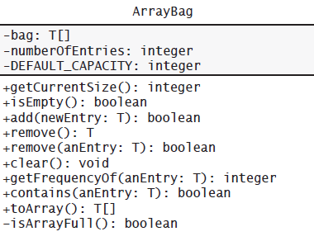
Fixed-Size Array
FIGURE 2-2 UML notation for the class ArrayBag, including the class’s data fields

Slide 10
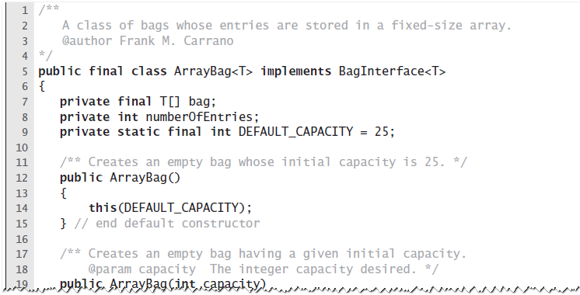
Fixed-Size Array
LISTING 2-1 An outline of the class ArrayBag

Slide 11
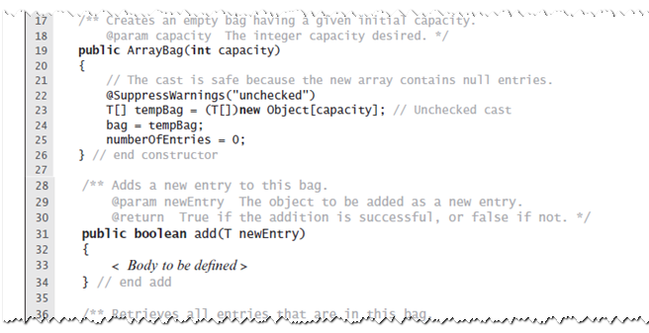
Fixed-Size Array
LISTING 2-1 An outline of the class ArrayBag

Slide 12
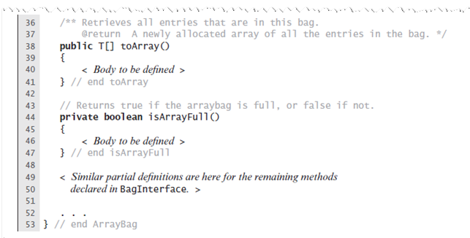
Fixed-Size Array
LISTING 2-1 An outline of the class ArrayBag

Slide 13
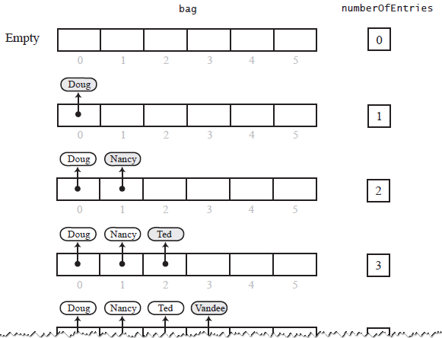
Fixed-Size Array
FIGURE 2-3 Adding entries to an array that represents a bag, whose capacity is six, until it becomes full

Slide 14
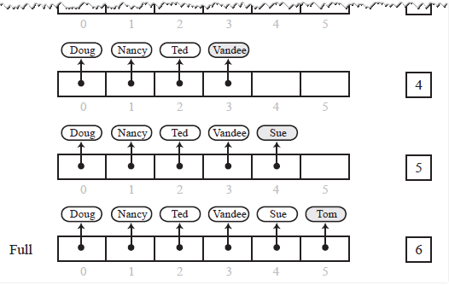
Fixed-Size Array
FIGURE 2-3 Adding entries to an array that represents a bag, whose capacity is six, until it becomes full

Slide 15
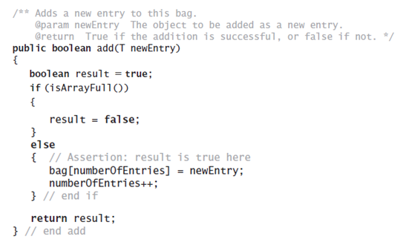
Fixed-Size Array
Method add

Slide 16
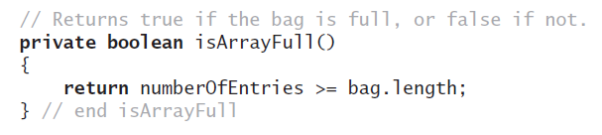
Fixed-Size Array
Method isFull

Slide 17
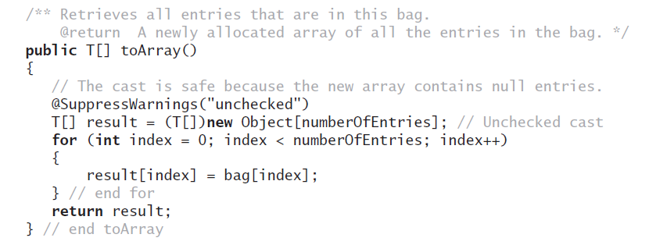
Fixed-Size Array
Method toArray

Slide 18
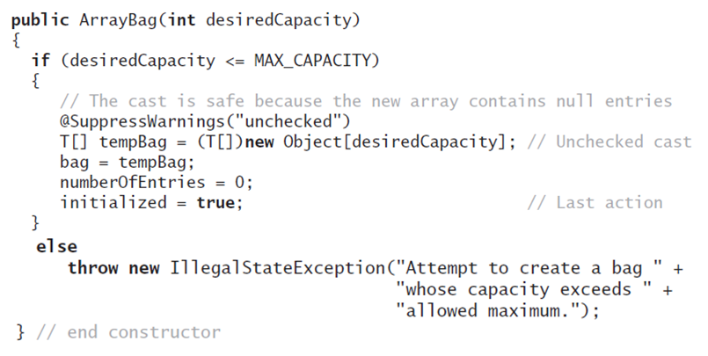
Making the Implementation Secure
Revised constructor

Slide 19
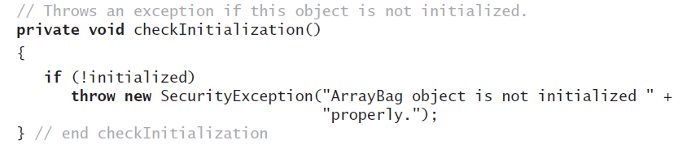
Making the Implementation Secure
Method to check initialization

Slide 20
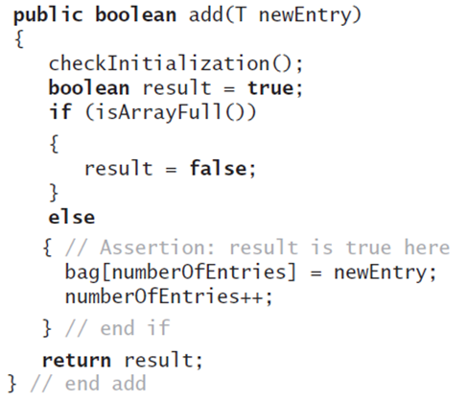
Making the Implementation Secure
Revise the method add

Slide 21
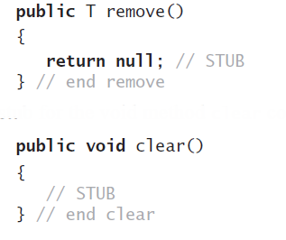
Testing the Core Methods
Stubs for remove and clear

Slide 22
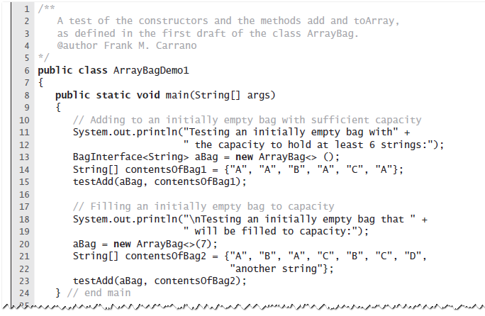
Testing the Core Methods
LISTING 2-2 A program that tests core methods of the class ArrayBag

Slide 23
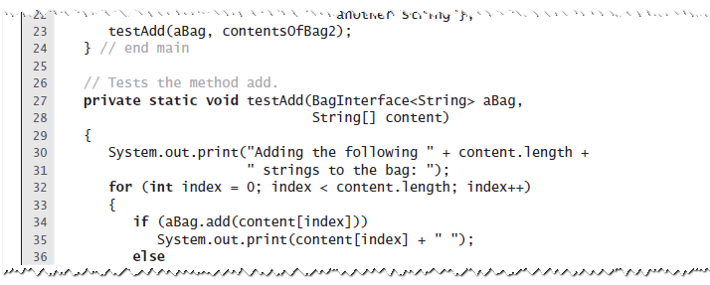
Testing the Core Methods
LISTING 2-2 A program that tests core methods of the class ArrayBag

Slide 24
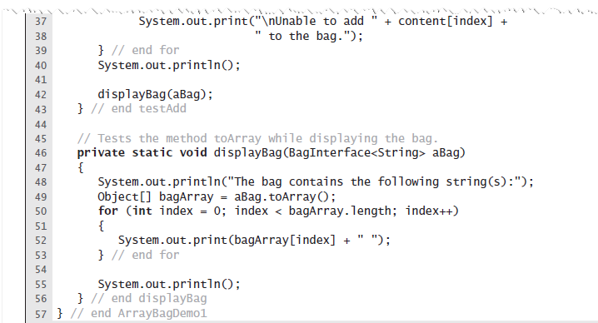
Testing the Core Methods
LISTING 2-2 A program that tests core methods of the class ArrayBag

Slide 25
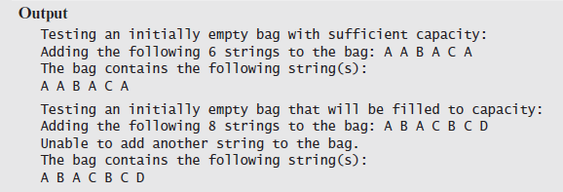
Testing the Core Methods
LISTING 2-2 A program that tests core methods of the class ArrayBag

Slide 26
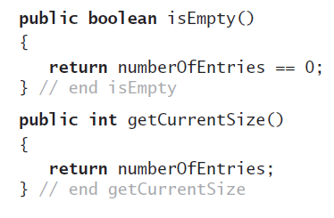
Implementing More Methods
Methods isEmpty and getCurrentSize

Slide 27
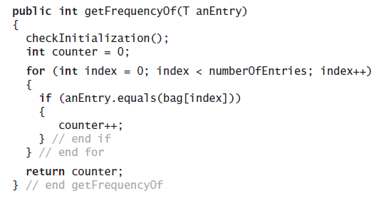
Implementing More Methods
Method getFrequencyOf

Slide 28
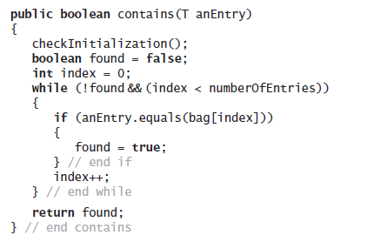
Implementing More Methods
Method contains

Slide 29
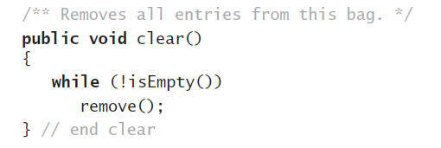
Methods That Remove Entries
The method clear

Slide 30
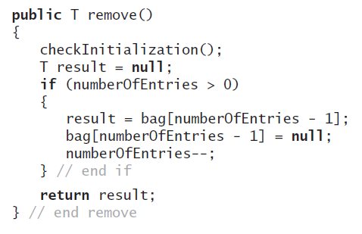
Methods That Remove Entries
The method remove

Slide 31
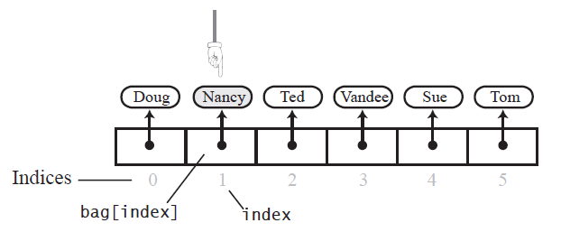
Methods That Remove Entries
FIGURE 2-4 The array bag after a successful search for the string “Nancy"

Slide 32
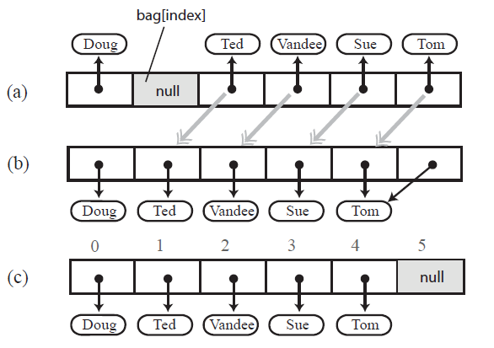
Methods That Remove Entries
FIGURE 2-5 (a) A gap in the array bag after setting the entry in bag[index] to null; (b) the array after shifting subsequent entries to avoid a gap

Slide 33
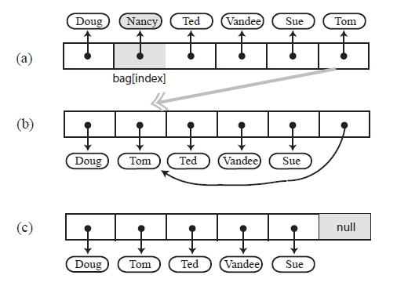
Methods That Remove Entries
FIGURE 2-6 Avoiding a gap in the array while removing an entry

Slide 34
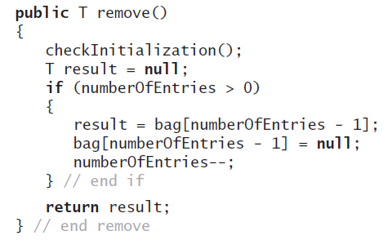
Methods That Remove Entries
New definition of remove

Slide 35
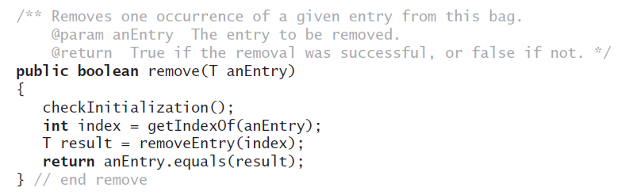
Methods That Remove Entries
The second remove method

Slide 36
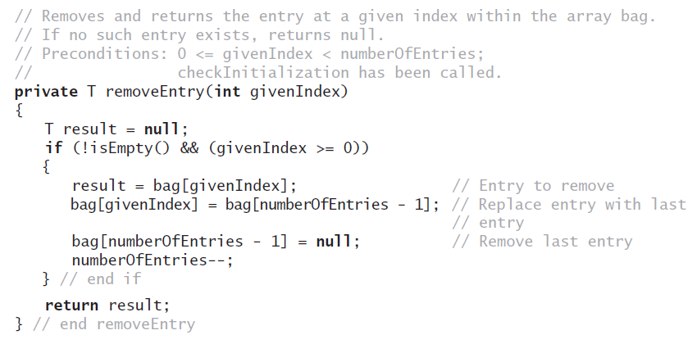
Methods That Remove Entries
The removeEntry method

Slide 37
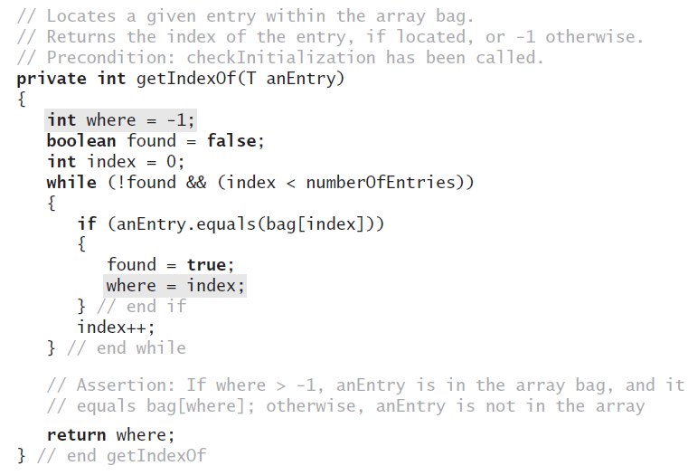
Methods That Remove Entries
Definition for the method getIndexOf

Slide 38
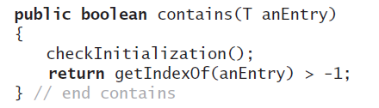
Methods That Remove Entries
Revised definition for the method contains

Slide 39
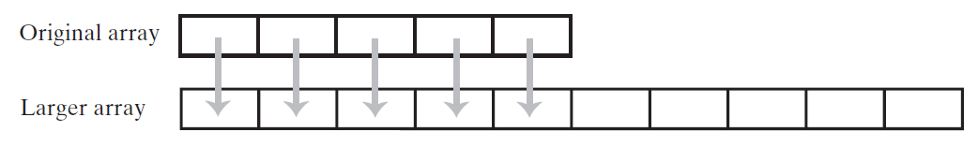
Using Array Resizing
FIGURE 2-7 Resizing an array copies its contents to a larger second array

Slide 40
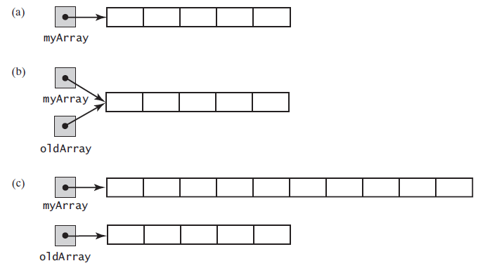
Using Array Resizing
FIGURE 2-8 (a) An array; (b) two references to the same array; (c) the original array variable now references a new, larger array;

Slide 41
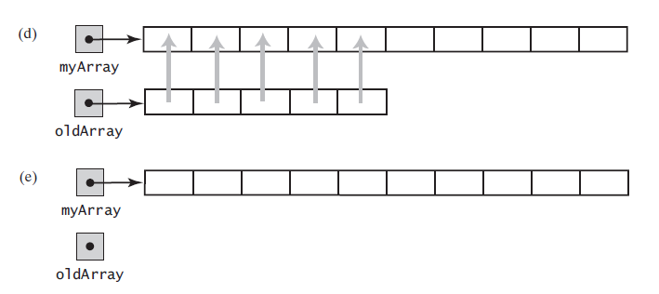
Using Array Resizing
FIGURE 2-8 (d) the entries in the original array are copied to the new array; (e) the original array is discarded

Slide 42
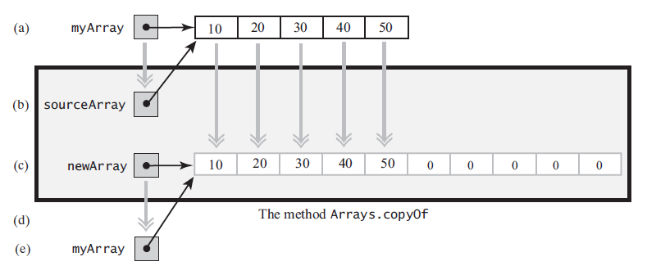
Using Array Resizing
FIGURE 2-9 The effect of the statement
myArray = Arrays.copyOf(myArray, 2 * myArray.length);
(a) The argument array; (b) the parameter that references the argument array; (c) a new, larger array that gets the contents of the argument array; (d) the return value that references the new array; (e) the argument variable is assigned the return value

Slide 43
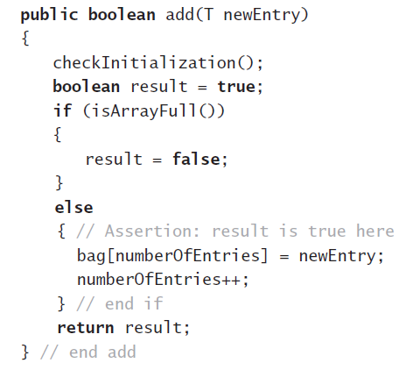
New Implementation of a Bag
Previous definition of method add

Slide 44
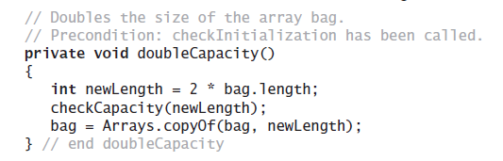
New Implementation of a Bag
Revision of method doubleCapacity

Slide 45
Pros and Cons of Using an Array
Adding an entry to the bag is fast
Removing an unspecified entry is fast
Removing a particular entry requires time to locate the entry
Increasing the size of the array requires time to copy its entries

Slide 46
END

